Slide 1
Decision Making Statements and Loop Statements

Slide 2
What are Decision Making Statements?
Decision making structures require that the programmer specify one or more conditions to be evaluated or tested by the program, along with a statement or statements to be executed if the condition is determined to be true, and optionally, other statements to be executed if the condition is determined to be false.

Slide 3
Various Decisions making statements
Sl.No | Statement & Description
1 | if statement An ‘if’ statement consists of a boolean expression followed by one or more statements.
2 | if...else statement An ‘if’ statement can be followed by an optional ‘else’ statement, which executes when the boolean expression is false.
3 | switch statement A ‘switch’ statement allows a variable to be tested for equality against a list of values.
4 | nested if statements You can use one ‘if’ or ‘else if’ statement inside another ‘if’ or ‘else if’ statement(s).
5 | nested switch statements You can use one ‘switch’ statement inside another ‘switch’ statement(s).

Slide 4
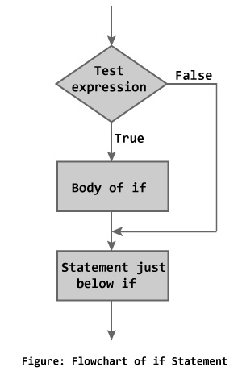
If statements
Syntax:-
if (expression)
{
statements inside;
}
Statements outside;
If the expression is true, then 'statement-inside' it will be executed, otherwise 'statement-inside' is skipped and only 'statement-outside' is executed.

Slide 5
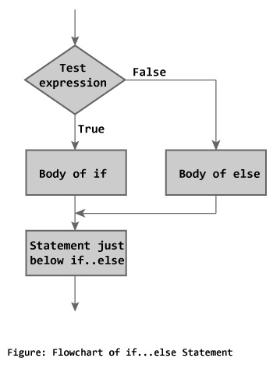
If else statements
Syntax:-
if (expression
{
statements block-1;
}
else
{
statements block-2;
}
If the 'expression' is true, the 'statement-block1' is executed, else 'statement-block1' is skipped and 'statement-block2' is executed.

Slide 6
Nested if else statements
Syntax:-
if(expression)
{
if(expression1)
{
statement block1;
}
else
{
statement block2;
}
}
else
{
statement block3;
}

Slide 7
if 'expression' is false the 'statement-block3' will be executed, otherwise it continues to perform the test for 'expression 1' . If the 'expression 1' is true the 'statement-block1' is executed otherwise 'statement-block2' is executed.

Slide 8
else if ladder
Syntax:-
if(expression 1)
{
statement-block2;
}
else if(expression 2)
{
statement-block2;
}
else if (expression3)
{
statement block3;
}
else
default- statement;

Slide 9
The expression is tested from the top(of the ladder) downwards. As soon as the true condition is found, the statement associated with it is executed.

Slide 10
Switch Statements
Syntax:-
switch (n)
{
case 1: // code to be executed if n = 1;
break;
case 2: // code to be executed if n = 2;
break;
default: // code to be executed if n doesn't match any cases
}

Slide 11
Switch case statements are a substitute for long if statements that compare a variable to several integral values
The switch statement is a multiway branch statement. It provides an easy way to dispatch execution to different parts of code based on the value of the expression.
Switch is a control statement that allows a value to change control of execution.
Duplicate case values are not allowed.
The default statement is optional.Even if the switch case statement do not have a default statement, it would run without any problem.
The break statement is used inside the switch to terminate a statement sequence. When a break statement is reached, the switch terminates, and the flow of control jumps to the next line following the switch statement.
The break statement is optional. If omitted, execution will continue on into the next case. The flow of control will fall through to subsequent cases until a break is reached.
Nesting of switch statements are allowed, which means you can have switch statements inside another switch. However nested switch statements should be avoided as it makes program more complex and less readable.

Slide 13
Loop Statements
A loop statement allows us to execute a statement or group of statements multiple times.
Sr.No | Loop Type & Description
1 | while loop Repeats a statement or group of statements while a given condition is true. It tests the condition before executing the loop body.
2 | for loop Execute a sequence of statements multiple times and abbreviates the code that manages the loop variable.
3 | do...while loop Like a ‘while’ statement, except that it tests the condition at the end of the loop body.
4 | nested loops You can use one or more loop inside any another ‘while’, ‘for’ or ‘do..while’ loop.

Slide 14
for loop
for loop is used to execute a set of statement repeatedly until a particular condition is satisfied. we can say it an open ended loop.
Syntax:-
for(initialization; condition; increment/decrement)
{
statement blocks;
}
In for loop we have exactly two semicolons, one after initialization and second after condition. In this loop we can have more than one initialization or increment/decrement, separated using comma operator. for loop can have only one condition.

Slide 15
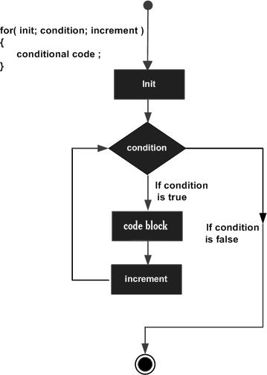

Slide 16
while loop
while loop can be address as an entry control loop. It is completed in 3 steps.
Variable initialization.( e.g int x=0; )
condition( e.g while( x<=10) )
Variable increment or decrement ( x++ or x-- or x=x+2 )

Slide 17
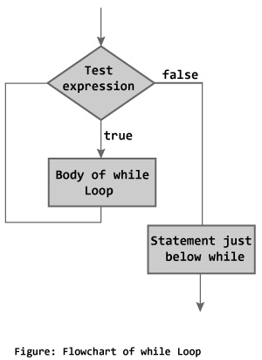
Syntax:-
Variable initialization;
while(condition)
{
statements;
variable increment / decrement;
}

Slide 18
do while loop
In some situations it is necessary to execute body of the loop before testing the condition. Such situations can be handled with the help of do-while loop. do statement evaluates the body of the loop first and at the end, the condition is checked using while statement.

Slide 19
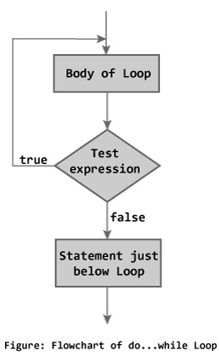
Syntax:-
do
{
statements;
}
while(condition);

Slide 20
Jumping out of loop
Sometimes, while executing a loop, it becomes necessary to skip a part of the loop or to leave the loop as soon as certain condition becomes true, that is jump out of loop.
C language allows jumping from one statement to another within a loop as well as jumping out of the loop.
We have 2 such statements.
1. break statements
2. continue statements

Slide 21
1. break statements
When break statement is encountered inside a loop, the loop is immediately exited and the program continues with the statement immediately following the loop.

Slide 22
2. continue statements
It causes the control to go directly to the test-condition and then continue the loop process.
On encountering continue, cursor leave the current cycle of loop, and starts with the next cycle

Slide 23
Thank you

